Slide 1
MY SQL PROJECT
by Thulasi Dharan R

Slide 2

□ MySQL is the world's most popular open source database. □ According to DB-Engines, MySQL ranks as the second- most-popular database, behind Oracle Database. □ MySQL powers many of the most accessed applications, including Facebook, Twitter, Netflix, Uber, Airbnb, Shopify, and Booking.com.

Slide 3
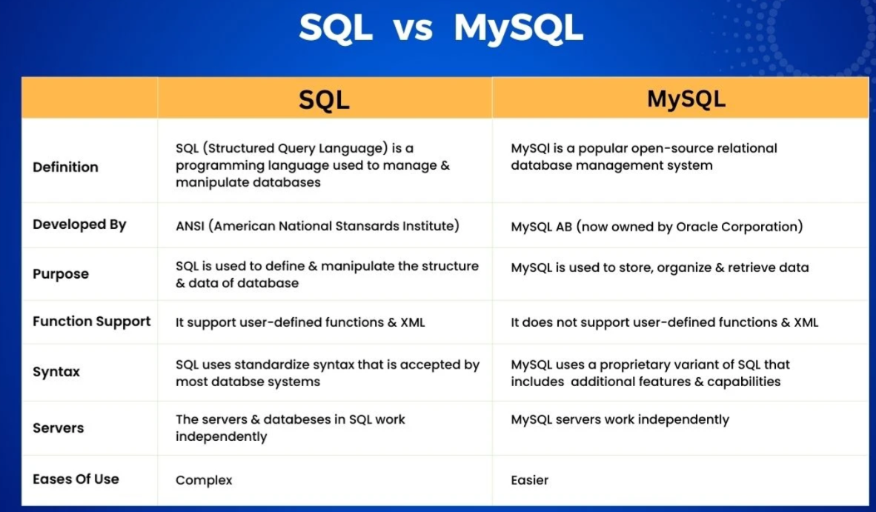

Slide 4

MYSQL SERVERS

Slide 5
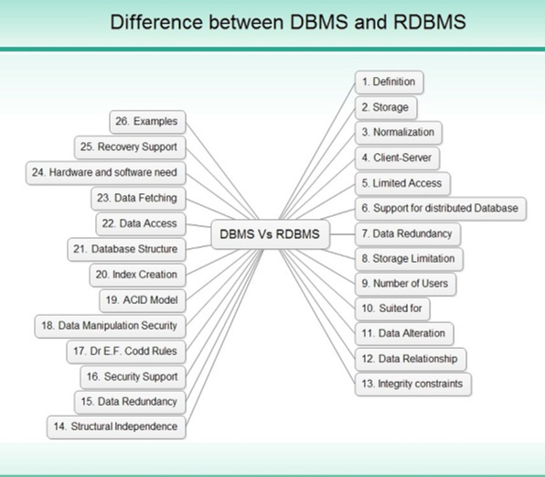

Slide 7

DATABASE

Slide 8
□ SQL database or relational database is a collection of highly structured tables, wherein each row reflects a data entity, and every column defines a specific information field.
□ Relational databases are built using the structured query language (SQL) to create, store, update, and retrieve data.
SQL Database Definition

Slide 9
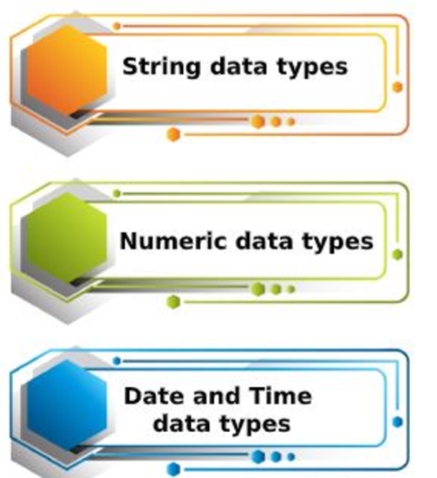
DATA TYPES

Slide 10
DATA TYPES EXPLANANTION
numeric data type
• In SQL, numeric data types are used to store numeric values such as integers, floating-point numbers, and decimal numbers.
• The choice of numeric data type depends on the range and precision of values you need to store.

Slide 11
Here are some common numeric data types in SQL
• INTEGER: This data type is used to store whole numbers (integers) without decimal points.
It typically occupies 4 bytes of storage.
• BIGINT: This data type is used to store large whole numbers (integers) without decimal points.
It typically occupies 8 bytes of storage, allowing for a larger range of values compared to INTEGER.
• DECIMAL(p, s) or NUMERIC(p, s): These data types are used to store fixed-point numbers with a specified precision p and scale s.
Precision refers to the total number of digits in the number, while scale refers to the number of digits to the right of the decimal point.
• FLOAT(p) or REAL: These data types are used to store floating-point numbers with a specified precision p.
The precision indicates the total number of digits that can be stored in the number.
• DOUBLE PRECISION: This data type is used to store double-precision floating-point numbers,
providing higher precision compared to FLOAT or REAL.

Slide 12
Date & Time Data type
The TIME data type consists of a time in hour, minutes, seconds, optional fractions of
a second, and optional time zone.
The format is as follows: TIME [time_precision]
[time_zone_spec] time_precision. (Optional) Indicates the number of digits of precision
in the fractions of seconds, as an integer value from 0 to 9.

Slide 13
string data types
SQL character/string data types are used to store alphanumeric characters in a database.
The most commonly used of these are CHAR and VARCHAR .
The CHAR data type is used to store fixed-length strings of characters, while the VARCHAR data type is used to store variable-length strings.

Slide 14
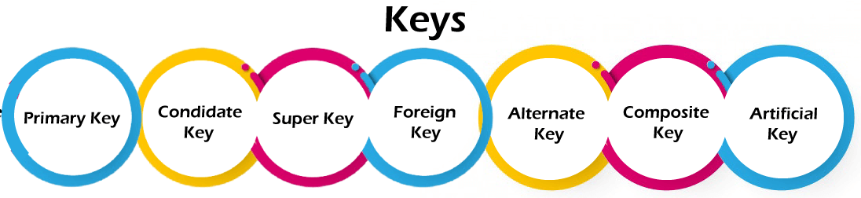
DBMS KEYS

Slide 15
Primary key:
It is the first key used to identify one and only one instance of an entity uniquely.
An entity can contain multiple keys, as we saw in the PERSON table.
The key which is most suitable from those lists becomes a primary key.
In the EMPLOYEE table, ID can be the primary key since it is unique for each employee.
In the EMPLOYEE table, we can even select License_Number and Passport_Number as primary keys since they are also unique
For each entity, the primary key selection is based on requirements and developers.

Slide 16
Candidate key:
A candidate key is an attribute or set of attributes that can uniquely identify a tuple.
Except for the primary key, the remaining attributes are considered a candidate key.
The candidate keys are as strong as the primary key.
For example: In the EMPLOYEE table, id is best suited for the primary key. The rest of the attributes, like SSN,
Passport_Number, License_Number, etc., are considered a candidate key.

Slide 17
Super Key:
Super key is an attribute set that can uniquely identify a tuple.
A super key is a superset of a candidate key.
For example: In the above EMPLOYEE table, for(EMPLOEE_ID, EMPLOYEE_NAME), the name of two employees can be the same,
but their EMPLYEE_ID can't be the same. Hence, this combination can also be a key.
The super key would be EMPLOYEE-ID (EMPLOYEE_ID, EMPLOYEE-NAME), etc.

Slide 18
Foreign key:
Foreign keys are the column of the table used to point to the primary key of another table.
Every employee works in a specific department in a company, and employee and department are two different entities. So we can't store the department's information in the employee table. That's why we link these two tables through the primary key of one table.
We add the primary key of the DEPARTMENT table, Department_Id, as
a new attribute in the EMPLOYEE table.
In the EMPLOYEE table, Department_Id is the foreign key, and both the tables are related.

Slide 19
Alternate key:
There may be one or more attributes or a combination of attributes that uniquely identify each tuple in a relation. These attributes or combinations of the attributes are called the candidate keys.
One key is chosen as the primary key from these candidate keys, and the remaining candidate key, if it exists, is termed the alternate key. In other words, the total number of the alternate keys is the total number of candidate keys minus the primary key.
The alternate key may or may not exist. If there is only one candidate key in a relation, it does not have an alternate key For example, employee relation has two attributes, Employee_Id and PAN_No, that act as candidate keys.
In this relation, Employee_Id is chosen as the primary key, so the other candidate key, PAN_No, acts as the Alternate key.

Slide 20
Composite key:
Whenever a primary key consists of more than one attribute, it is known as a composite key. This key is also known as Concatenated Key.
For example, in employee relations, we assume that an employee may be assigned multiple roles, and an employee may work on multiple projects simultaneously. So the primary key will be composed of all three attributes, namely Emp_ID, Emp_role, and Proj_ID in combination.
So these attributes act as a composite key since the primary key comprises more than one attribute.

Slide 21
Artificial key:
The key created using arbitrarily assigned data are known as artificial keys.
These keys are created when a primary key is large and complex and has no relationship with many other relations.
The data values of the artificial keys are usually numbered in a serial order.
For example, the primary key, which is composed of Emp_ID, Emp_role, and Proj_ID, is large in employee relations. So it would be better to add a new virtual attribute to identify each tuple in the relation uniquely.

Slide 22
My SQL Main Commands
□ Create database
□ Show Database
□ Drop Database
□ Alter Database
□ Create Tables
□ Show tables
□ Insert Values
□ Drop Table
□ Alter table
□ Alter Table Modify
□ Alter table Drop
□ Alter table Rename
□ Update Table
□ Delete Statement

Slide 23
create database windows;

Slide 24
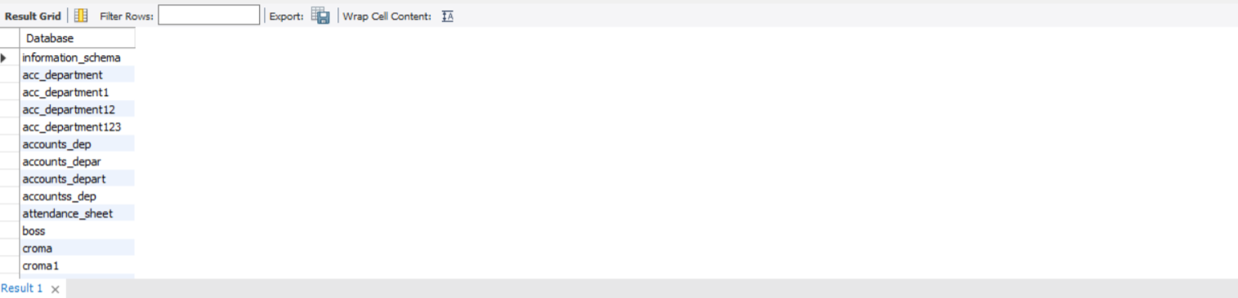
show database ;

Slide 25
drop database window;

Slide 26
alter table student_details modify gender varchar (15);

Slide 27
CREATE TABLE STUDENT_INFO (Student_ID INT NOT NULL AUTO_INCREMENT,Student_Name VARCHAR(20) NOT NULL,City_State VARCHAR(15) NOT NULL,Age INT NOT NULL,Result VARCHAR(15) NOT NULL,Marks INT NOT NULL,PRIMARY KEY (STUDENT_ID));

Slide 28
show tables;

Slide 29
insert into sal_info values (121, 1, '2022-06-10', 10000), (156, 2, '2022-06-12', 18000), (134, 3, '2022-06-15', 12000), (167, 4, '2022-06-20', 16000), (178, 5, '2022-06-23', 12000);

Slide 30
drop table student_det;

Slide 31
alter table student10_det auto_increment=101;

Slide 32
alter table student_details modify gender varchar (15);

Slide 33
alter table student10_det DROP city_state;

Slide 34
alter table student10_det rename to student_details;

Slide 35
update student_info set age = 18 where student_id =26;

Slide 36
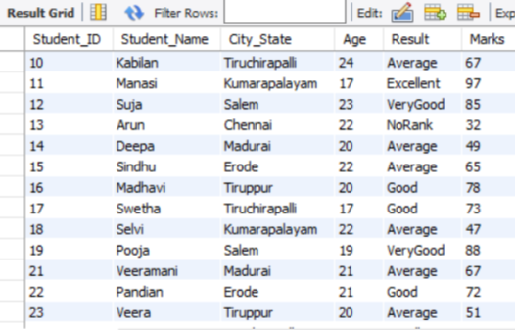
delete from student_info where student_id=20;

Slide 37
My SQL General Functions
Where
or
and
in
Not in
>
<
>=
<=
<> (Not equal to)
!
Distinct
Count With Distinct
Order by Asc
Order By Desc
Count
Group By
Limit
Desc Limit
Like (_%)
Not like
Between

Slide 38
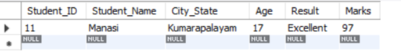
select * from student_info where marks='97’;

Slide 39
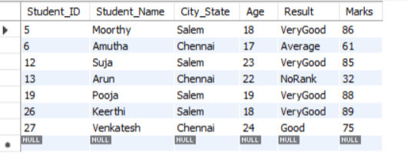
select * from student_info where city_state='chennai' or city_state='salem';

Slide 40
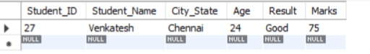
select * from student_info where city_state='chennai' and result='good';

Slide 41
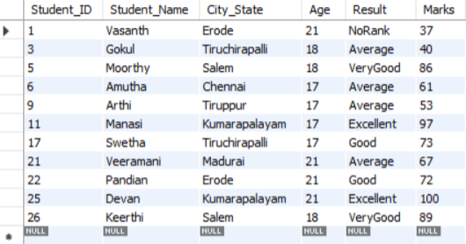
select * from student_info where age in ('17','18','21');

Slide 42
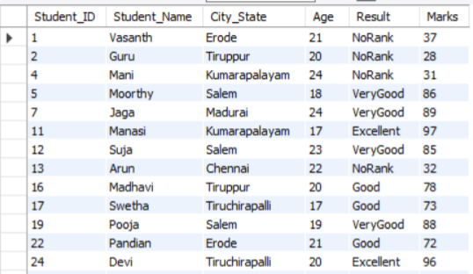
select * from student_info where result not in ( 'Average');

Slide 43
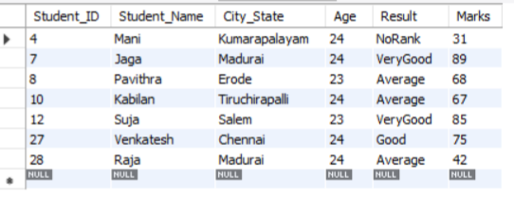
select * from student_info where age >22;

Slide 44
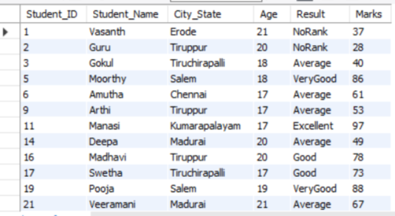
select * from student_info where age <22;

Slide 45
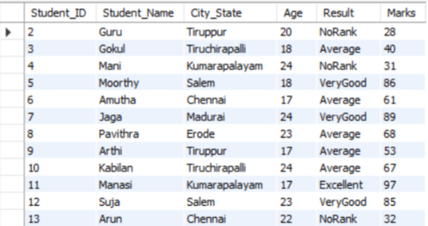
select * from student_info where age < > 21;

Slide 46
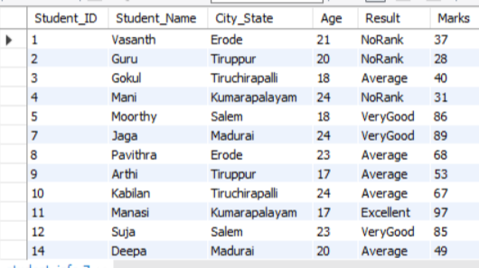
select * from student_info where city_state !='chennai';

Slide 47
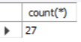
select count(*) from student_info;

Slide 48
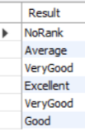
select distinct Result from student_info;

Slide 49
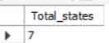
select count(distinct city_state) as Total_states from student_info;

Slide 50
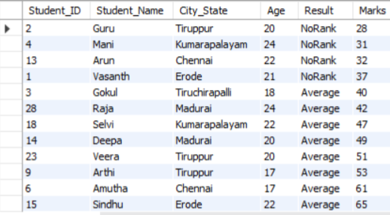
select * from student_info order by marks asc;

Slide 51
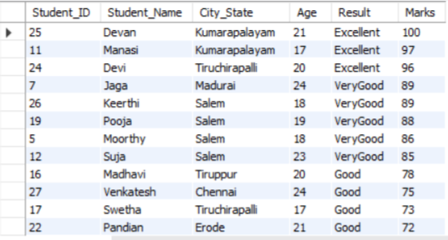
select * from student_info order by marks desc;

Slide 52
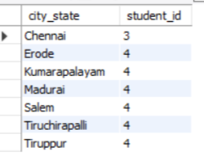
select city_state, count(student_id) as student_id fromstudent_info group by city_state;

Slide 53
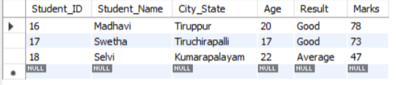
select * from student_info limit 15,3;

Slide 54
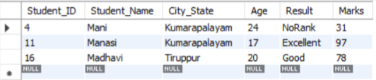
select * from student_info where student_name like 'Ma%';

Slide 55
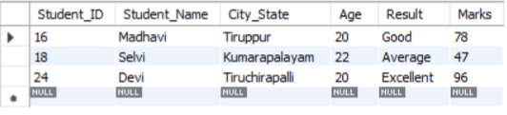
select * from student_info where student_name like '%vi';

Slide 56
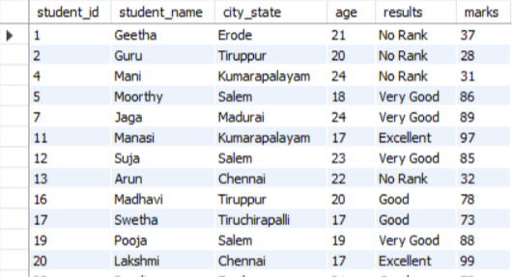
select * from student_det where results not like 'Average';

Slide 57
MY SQL Calculate Functions
Sum
Average
Min
Max
Count

Slide 58
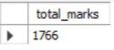
select sum(marks) as total_marks from student_info;

Slide 59
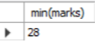
select min(marks) from student_info;

Slide 60
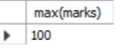
select max(marks) from student_info;

Slide 61
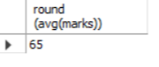
select round (avg(marks)) from student_info;

Slide 62
Lcase Ucase Left Right Concat Trim Char_Length Mid Length
My SQL String Functions

Slide 63
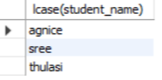
select lcase(student_name) from student_det;

Slide 64
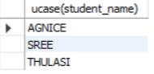
select ucase(student_name) from student_det;

Slide 65
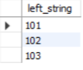
select left(student_id,3) as left_string from studenT_det;

Slide 66
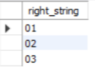
select right(student_id,2) as right_string from student_det;

Slide 67
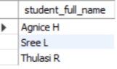
select concat (student_name," ",student_initial)as student_full_name from student_det;

Slide 68
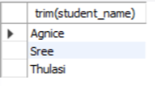
select trim(student_name) from student_det;

Slide 69
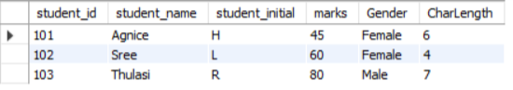
select *, char_length(student_name)as CharLengthfrom student_det;

Slide 70
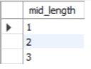
select mid(student_id,3,2) as mid_length fromstudent_det;

Slide 71
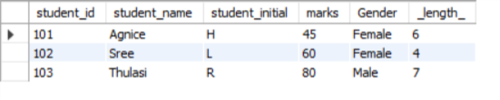
select *, length(student_name) as _length_ fromstudent_det;

Slide 72
Date ADD Datediff Timestamp Diff Date Format Year Day Month
My SQL Date Functions

Slide 73
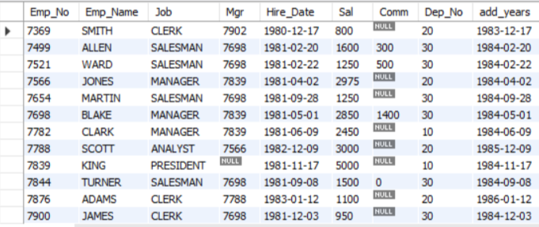
select*, date_add(hire_date,interval 3 year) as add_years from emp_info;

Slide 74
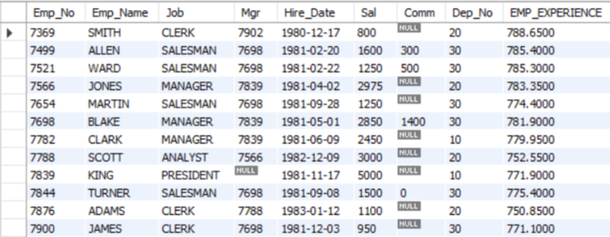
select*, datediff(curdate(),hire_date)/20 as EMP_EXPERIENCE FROM emp_info;

Slide 75
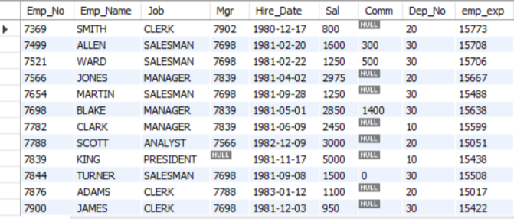
select *, timestampdiff(day,hire_date,curdate())as emp_exp from emp_info;

Slide 76
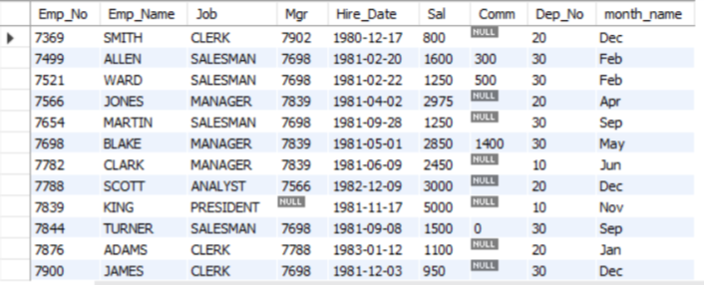
select *, date_format(hire_date,'%b') as month_name from emp_info;

Slide 77
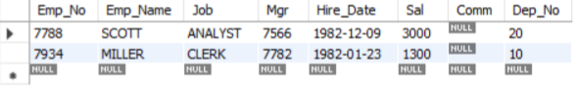
select * from emp_info where year(hire_date)='1982';

Slide 78
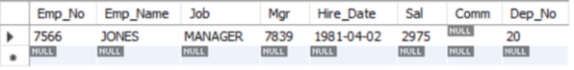
select * from emp_info where day(hire_date)='02';

Slide 79
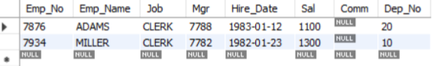
select * from emp_info where month(hire_date)='01';

Slide 80
□ IF □ If with and conditions □ If with or conditions □ Count If
Logical Functions

Slide 81
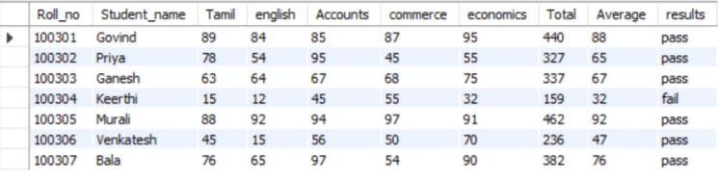
select*, if (average>=35,'pass','fail') as results from student_info;

Slide 82
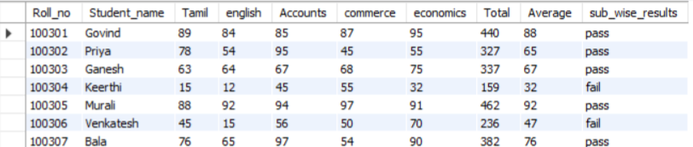
select*, if ((tamil>=35) and (english>=35) and (accounts>=35)and(commerce>35) and (economics>=35),'pass','fail') as sub_wise_results from student_info;

Slide 83
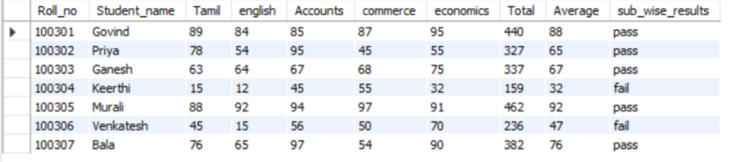
select*, if ((tamil<35) or (english<35) or (accounts<35)or(commerce<35) or (economics<35),'fail','pass') as sub_wise_results from student_info;

Slide 84
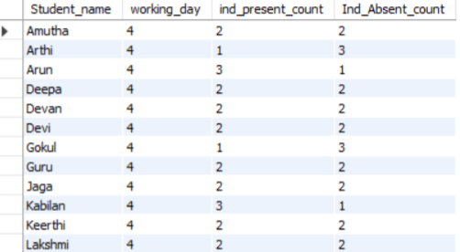
select Student_name, count(Att_status)as working_day, count(if(att_status = ' p','1',null)) as ind_present_count,count(if(att_status = ' A','1',null)) as Ind_Absent_count from att_info group by student_name;

Slide 85
□ Inner Join □ Left Join □ Right Join □ Cross join □ Full Outer Join □ when □ then □ basic joins Trigger (Create table after connections)
Join Queries

Slide 86
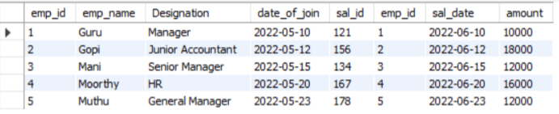
select* from emp_det inner join sal_info on emp_det . emp_id=sal_info.emp_id order by emp_det.emp_id asc;

Slide 87

select * from emp_det left join sal_info on emp_det.emp_id=sal_info.emp_id;

Slide 88

select * from emp_det right join sal_info on emp_det.emp_id= sal_info.emp_id;

Slide 89

(select * from emp_det left join sal_info on emp_det.emp_id=sal_info.emp_id)union(select * from emp_det right join sal_info on emp_det.emp_id=sal_info.emp_id);

Slide 90
Create table Student_Course_Info as select Student_Det.Student_Name, Student_Det.City_State, Student_Det.Roll_No, Student_Det.Course_ID, Course_Info.Course_Name, Marks_Info.Finance, Marks_Info.Cost, Marks_Info.Corporate,(Marks_Info.Finance+Marks_Info.Cost+Marks_Info . Corporate)asTotal_Marks,Round((Marks_Info.Finance+Marks_Info.Cost+Marks_Info.Corporate)/3,0) as Average from Student_Det inner join Course_info on Student_Det.Course_ID = Course_Info.Course_ID inner join Marks_info on Student_Det.Student_Id=Marks_Info.student_ID;

Slide 91

Procedures concepts (SQL Automation) delimiter // create procedure store_data2() begin select * from student_det; select *, case when city_state = 'Erode' then 500 when city_state = 'Tiruppur' then 700 when city_state = 'Tiruchirapalli' then 400 when city_state = 'Kumarapalayam' then 350 when city_state = 'Salem' then 700 when city_state = 'Chennai' then 800 when city_state = 'Madurai' then 1000 end as Bus_pass_det from student_det; select * from student_det where city_state = 'chennai 'and age >=22; end // delimiter ; call store_data2;

Slide 92
□ before insert □ after insert □ before update □ after update
Triggers (SQL Automation)

Slide 93
trigger before insert delimiter // create trigger Age_check before insert on student_det for each row begin if new . age<=0 then set new.age=0; end if; end // delimiter ;

Slide 94
trigger after insert Delimiter // create trigger backup_update after insert on student_det for each row begin insert into student_backup_det(student_id,student_name,city_state,age, community,marks)values (new.student_id,new.student_name,new.city_state,new.age,new. community,new.marks); end // delimiter ;

Slide 95
.TRIGGER BEFORE UPDATE delimiter // create trigger Update_salary Before update onemp_info for each row begin If new. salary >= 40000 thenset new.salary = 'High_salary’; elseif new.salary >= 35000 thenset new.salary = 'Good_salary’; elseif new.salary >=15000 thenset new.salary = 'average_salary’; elseif new.salary >=0 thenset new.salary = 'low_salary’; end if; end // delimiter ;

Slide 96
TRIGGER AFTER UPDATE delimiter // create trigger sal_grade_update after update on emp_info1 for each row begin if new.salary >= 40000 then insert into emp_salary1 values(new.emp_id, 'High Salary’); elseif new.salary >= 35000 then insert into emp_salary1 values(new.emp_id, 'Good Salary’); elseif new.salary >= 15000 then insert into emp_salary1 values(new.emp_id, 'Average Salary’); elseif new.salary >= 0 then insert into emp_salary1 values(new.emp_id, 'Low Salary’); end if; end // delimiter ;

Slide 97
THANK YOU

